Slide 1
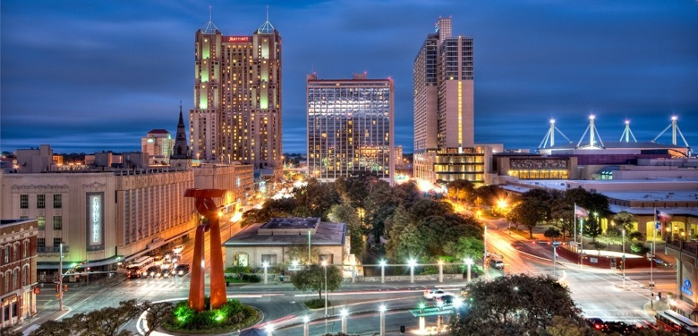

Global Business Travel Association, San Antonio
Presented by: Mario Hernandez, President, SAEDF
February 2, 2016

Slide 2
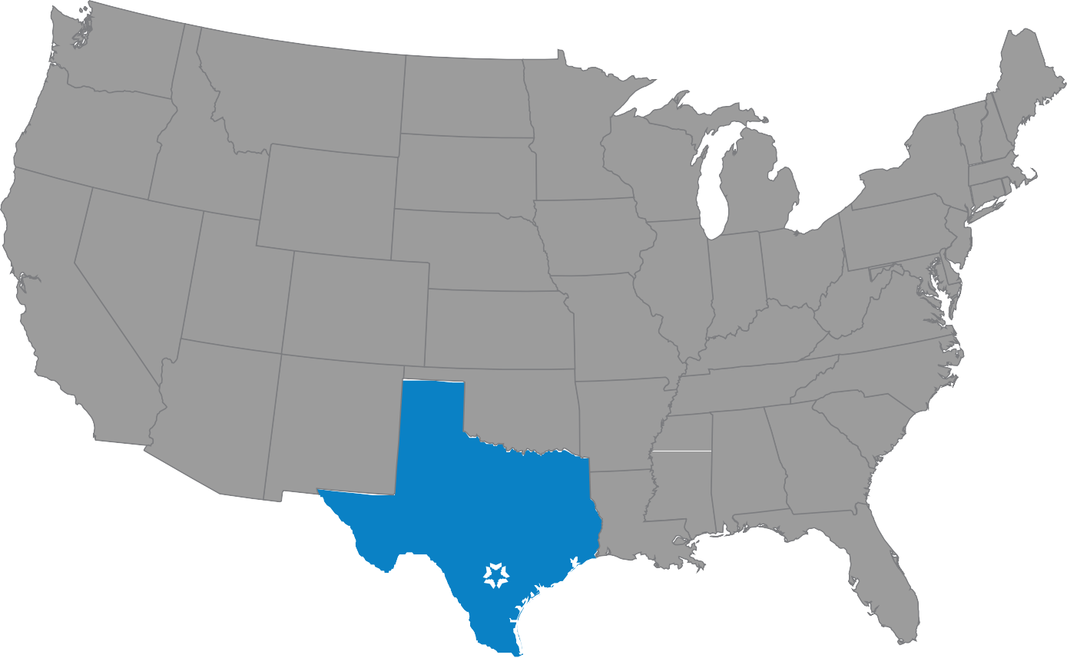
San Antonio Area Snapshot
9th fastest-growing city in the U.S.
Population – over 2.3 million
Labor Force – over 1.1 million
Median age – 33, among the youngest U.S. cities
Cost of living – 12.7 percentage points below the national average
Median sales price of single-family home - $184,200
Unemployment rate – six-year timeframe – never above 7.4% (Nov. 2015: 3.8%)

Slide 3
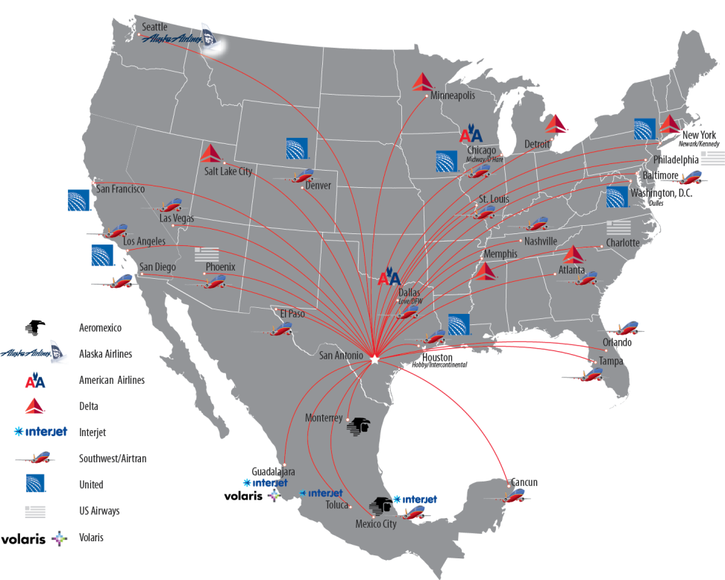
Connectivity
Several non-stop and direct flights to New York on multiple airlines.
Direct access to Mexico’s business centers.
Proximity to Dallas and Houston provides easy access to all global destinations.
Crossroads of 3 major interstates and rail lines for fast movement north, south, east, and west.
Central Time Zone allows city to service all of the Americas.

Slide 4
San Antonio – Secretly Cool
Vibrant, successful downtown
Geekdom
Museums & Galleries
Craft Breweries & Distilleries
Symphony Orchestra, Opera, and Tobin Center
Bicycle Paths & Bike-Share (13-mile linear park downtown)
Nature Trails and Kayaking Tours

Slide 5
Solid Economic Foundation
Strong presence of Biomedical, Aerospace, Cybersecurity, Cloud Computing, Energy, and Defense companies.
Only large U.S. city with Triple-A Bond Rating from all three rating agencies.
City-owned water utility and energy utility.
Geography means low incidence of disruptive weather or natural disasters.

Slide 6




What others are saying about San Antonio
2015 Best Performing Cities: Where America’s jobs are created and sustained –Milken Institute
Top 5 fastest-growing U.S. cites –CNN Money
Top 5 “secretly cool” city in the U.S. –Huffington Post
5th hottest real estate market to watch in 2016 –Trulia
Top 10 for business startups –Business Facilities
San Antonio out paces Austin, Houston in Millennial gains –Bloomberg
The “New Capital of Influence” in the U.S. –Forbes
No. 1 “U.S. Metros with the Most ‘Brain Gain’” –Brookings Institution
No. 1 “Best Cities for Young Graduates” –Forbes

Slide 7
San Antonio Advantages
Workforce of 1,100,000+
Cost of living 12.7 percentage points below the national average
Local government that values growth
Affordable land & energy
Workforce of 1,000,000+
15 colleges & universities enrolling 160,000+ students

Slide 8
San Antonio: Population and Labor Force
Year | Total Population | % Change from Previous Year | Total Civilian Labor Force | % Change from Previous Year
2012 | 2,194,927 | 2.45% | 1,001,416 | 2.64%
2013 | 2,256,780 | 2.82% | 1,025,485 | 2.40%
2014 | 2,289,691 | 1.46% | 1,056,403 | 3.01%
2015 (Nov 2014-Nov 2015) | 2,336,330 | 2.04% | 1,107,710 | 0.47%
Source: Bureau of Labor Statistics

Slide 9
Employment Growth: 12 Months Through November 2015
Place | November 2014 | November 2015 | Actual Change 2014-2015 | % Change Between 2014-2015
San Antonio-New Braunfels | 1,057,990 | 1,065,911 | 7,921 | 0.75%
Austin-Round Rock-San Marcos | 1,019,187 | 1,028,522 | 9,335 | 0.92%
Houston-Sugar Land-Baytown | 3,147,389 | 3,090,879 | -56,510 | -1.80%
Dallas-Fort Worth-Arlington | 3,438,689 | 3,448,535 | 9,846 | 0.29%
Texas | 12,551,420 | 12,472,249 | -79,171 | -0.63%
US | 149,056,000 | 149,308,000 | 252,000 | 0.17%
Source: Bureau of Labor Statistics, Texas Workforce Commission

Slide 10
Unemployment Rate (%)
Place | November 2015 | December 2014 | December 2013
San Antonio-New Braunfels | 3.8 | 3.8 | 4.9
Austin-Round Rock-San Marcos | 3.3 | 3.4 | 4.3
Houston-Sugar Land-Baytown | 4.9 | 4.1 | 5.1
Dallas-Fort Worth-Arlington | 4.0 | 4.0 | 5.2
Texas | 4.6 | 4.6 | 5.6
US | 5.0 | 5.6 | 6.7
Source: Bureau of Labor Statistics, Texas Workforce Commission

